Slide 1



Bank UPI Transaction 2024 From Excel
View in Power BI
Last data refresh:
12/25/2025 4:17:55 PM UTC
Downloaded at:
12/25/2025 4:18:56 PM UTC

Slide 2
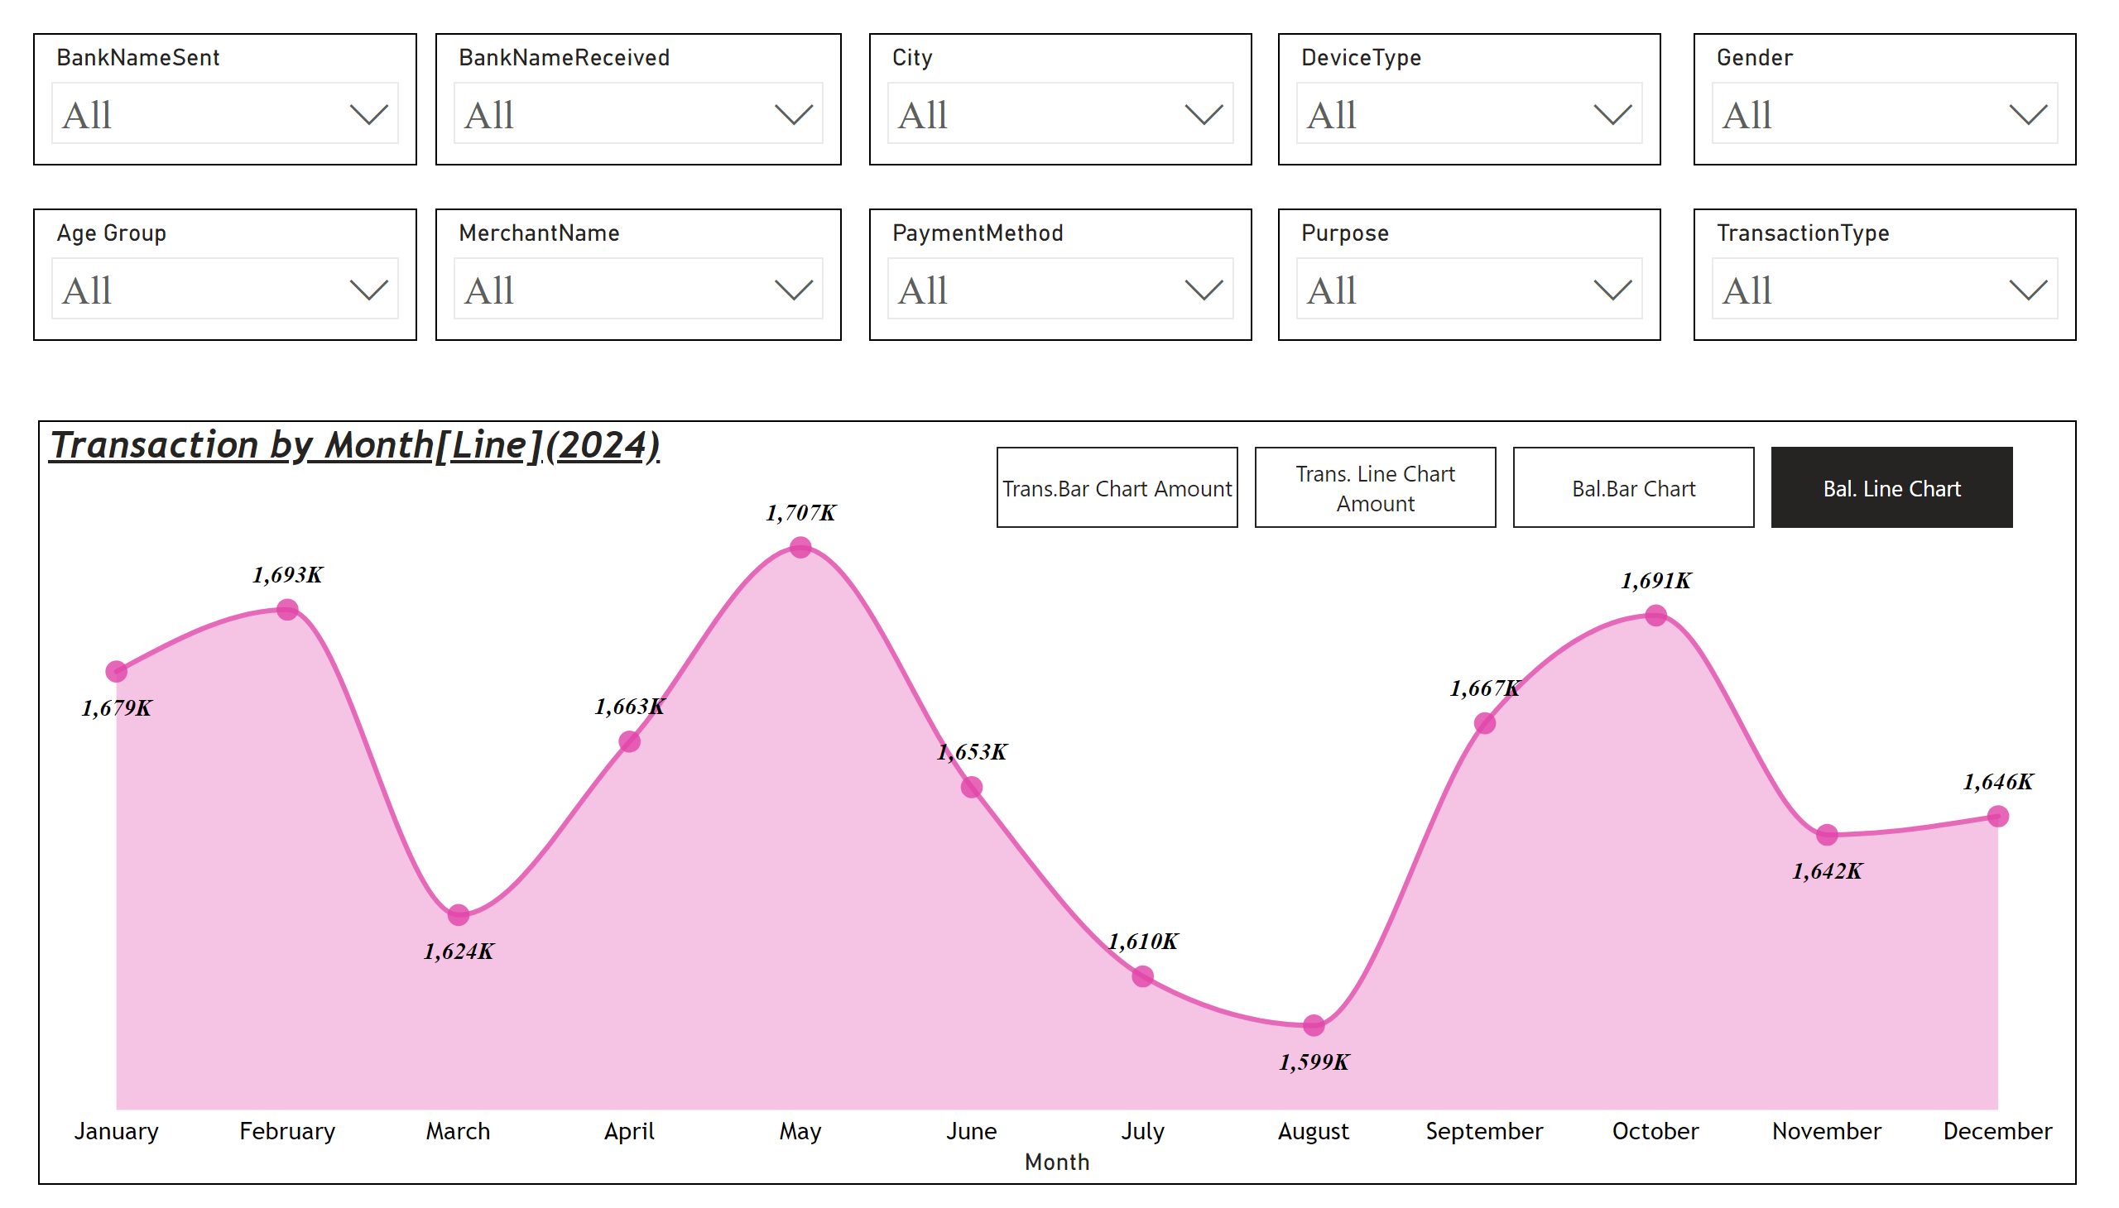
Line
Notes:
slicer
No alt text provided
slicer
No alt text provided
slicer
No alt text provided
slicer
No alt text provided
slicer
No alt text provided
slicer
No alt text provided
slicer
No alt text provided
slicer
No alt text provided
slicer
No alt text provided
slicer
No alt text provided
Transaction by Month[Line](2024)
No alt text provided
Transaction by Month[Column](2024)
No alt text provided
columnChart
No alt text provided
lineChart
No alt text provided
bookmarkNavigator
No alt text provided

Slide 3
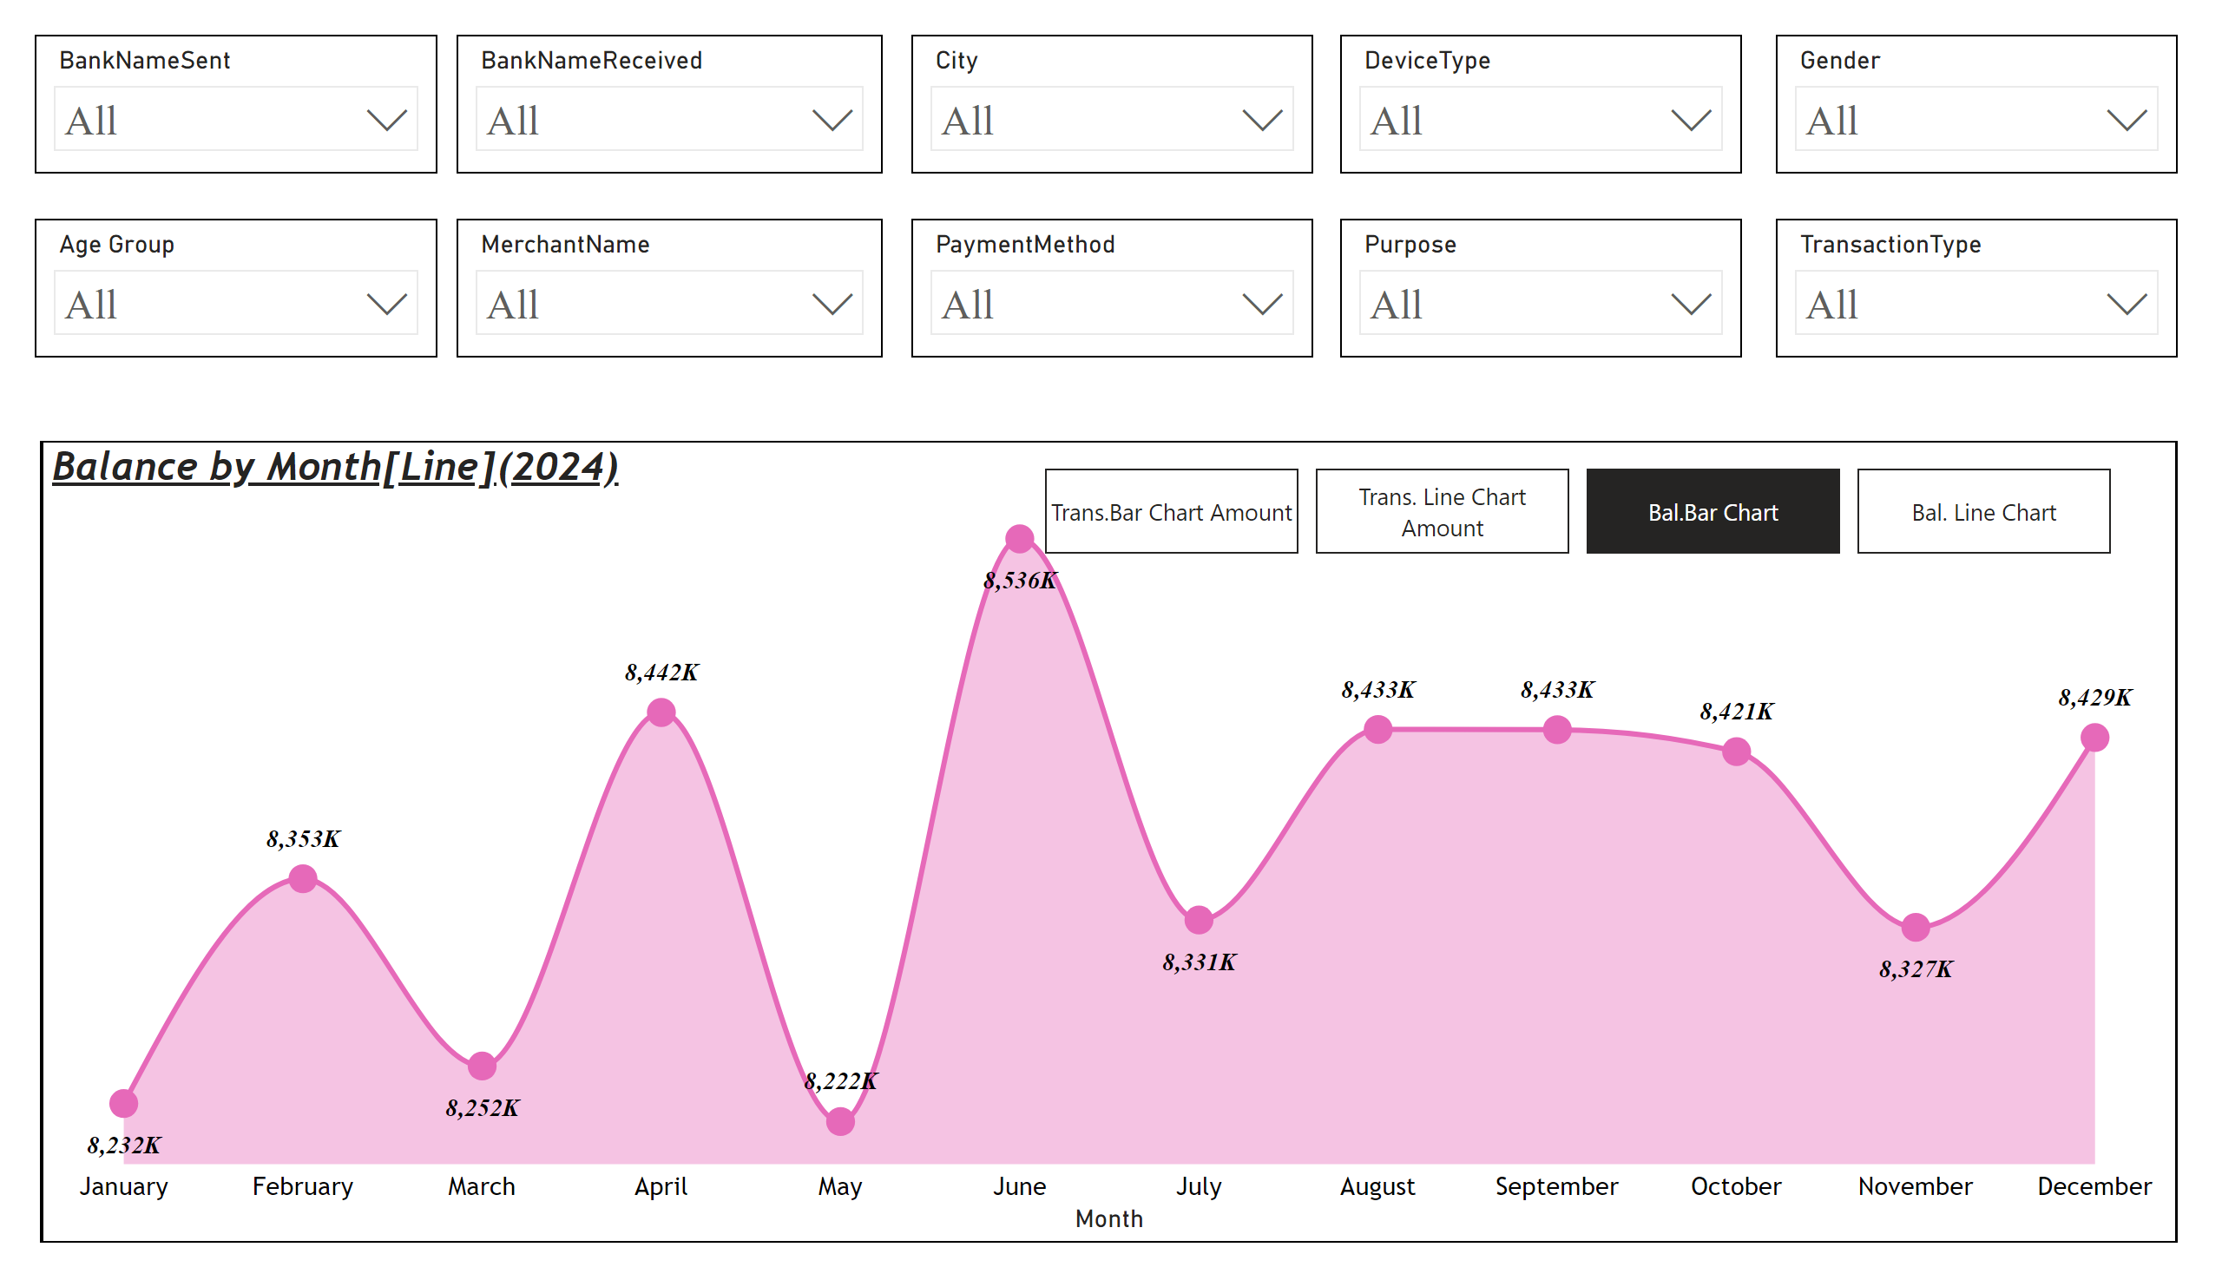
Bar
Notes:
slicer
No alt text provided
slicer
No alt text provided
slicer
No alt text provided
slicer
No alt text provided
slicer
No alt text provided
slicer
No alt text provided
slicer
No alt text provided
slicer
No alt text provided
slicer
No alt text provided
slicer
No alt text provided
lineChart
No alt text provided
Transaction by Month[Column](2024)
No alt text provided
columnChart
No alt text provided
Balance by Month[Line](2024)
No alt text provided
bookmarkNavigator
No alt text provided

Slide 4
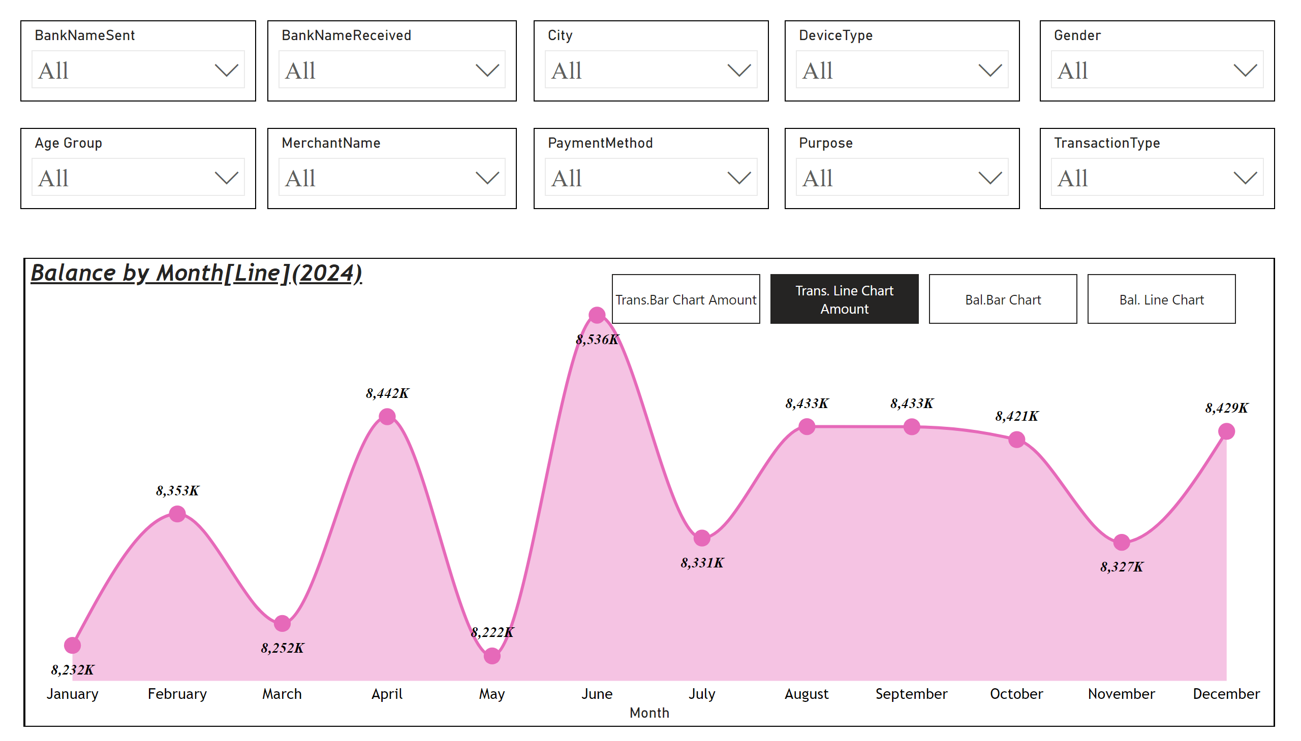
Tran Line
Notes:
slicer
No alt text provided
slicer
No alt text provided
slicer
No alt text provided
slicer
No alt text provided
slicer
No alt text provided
slicer
No alt text provided
slicer
No alt text provided
slicer
No alt text provided
slicer
No alt text provided
slicer
No alt text provided
lineChart
No alt text provided
Transaction by Month[Column](2024)
No alt text provided
columnChart
No alt text provided
Balance by Month[Line](2024)
No alt text provided
bookmarkNavigator
No alt text provided

Slide 5
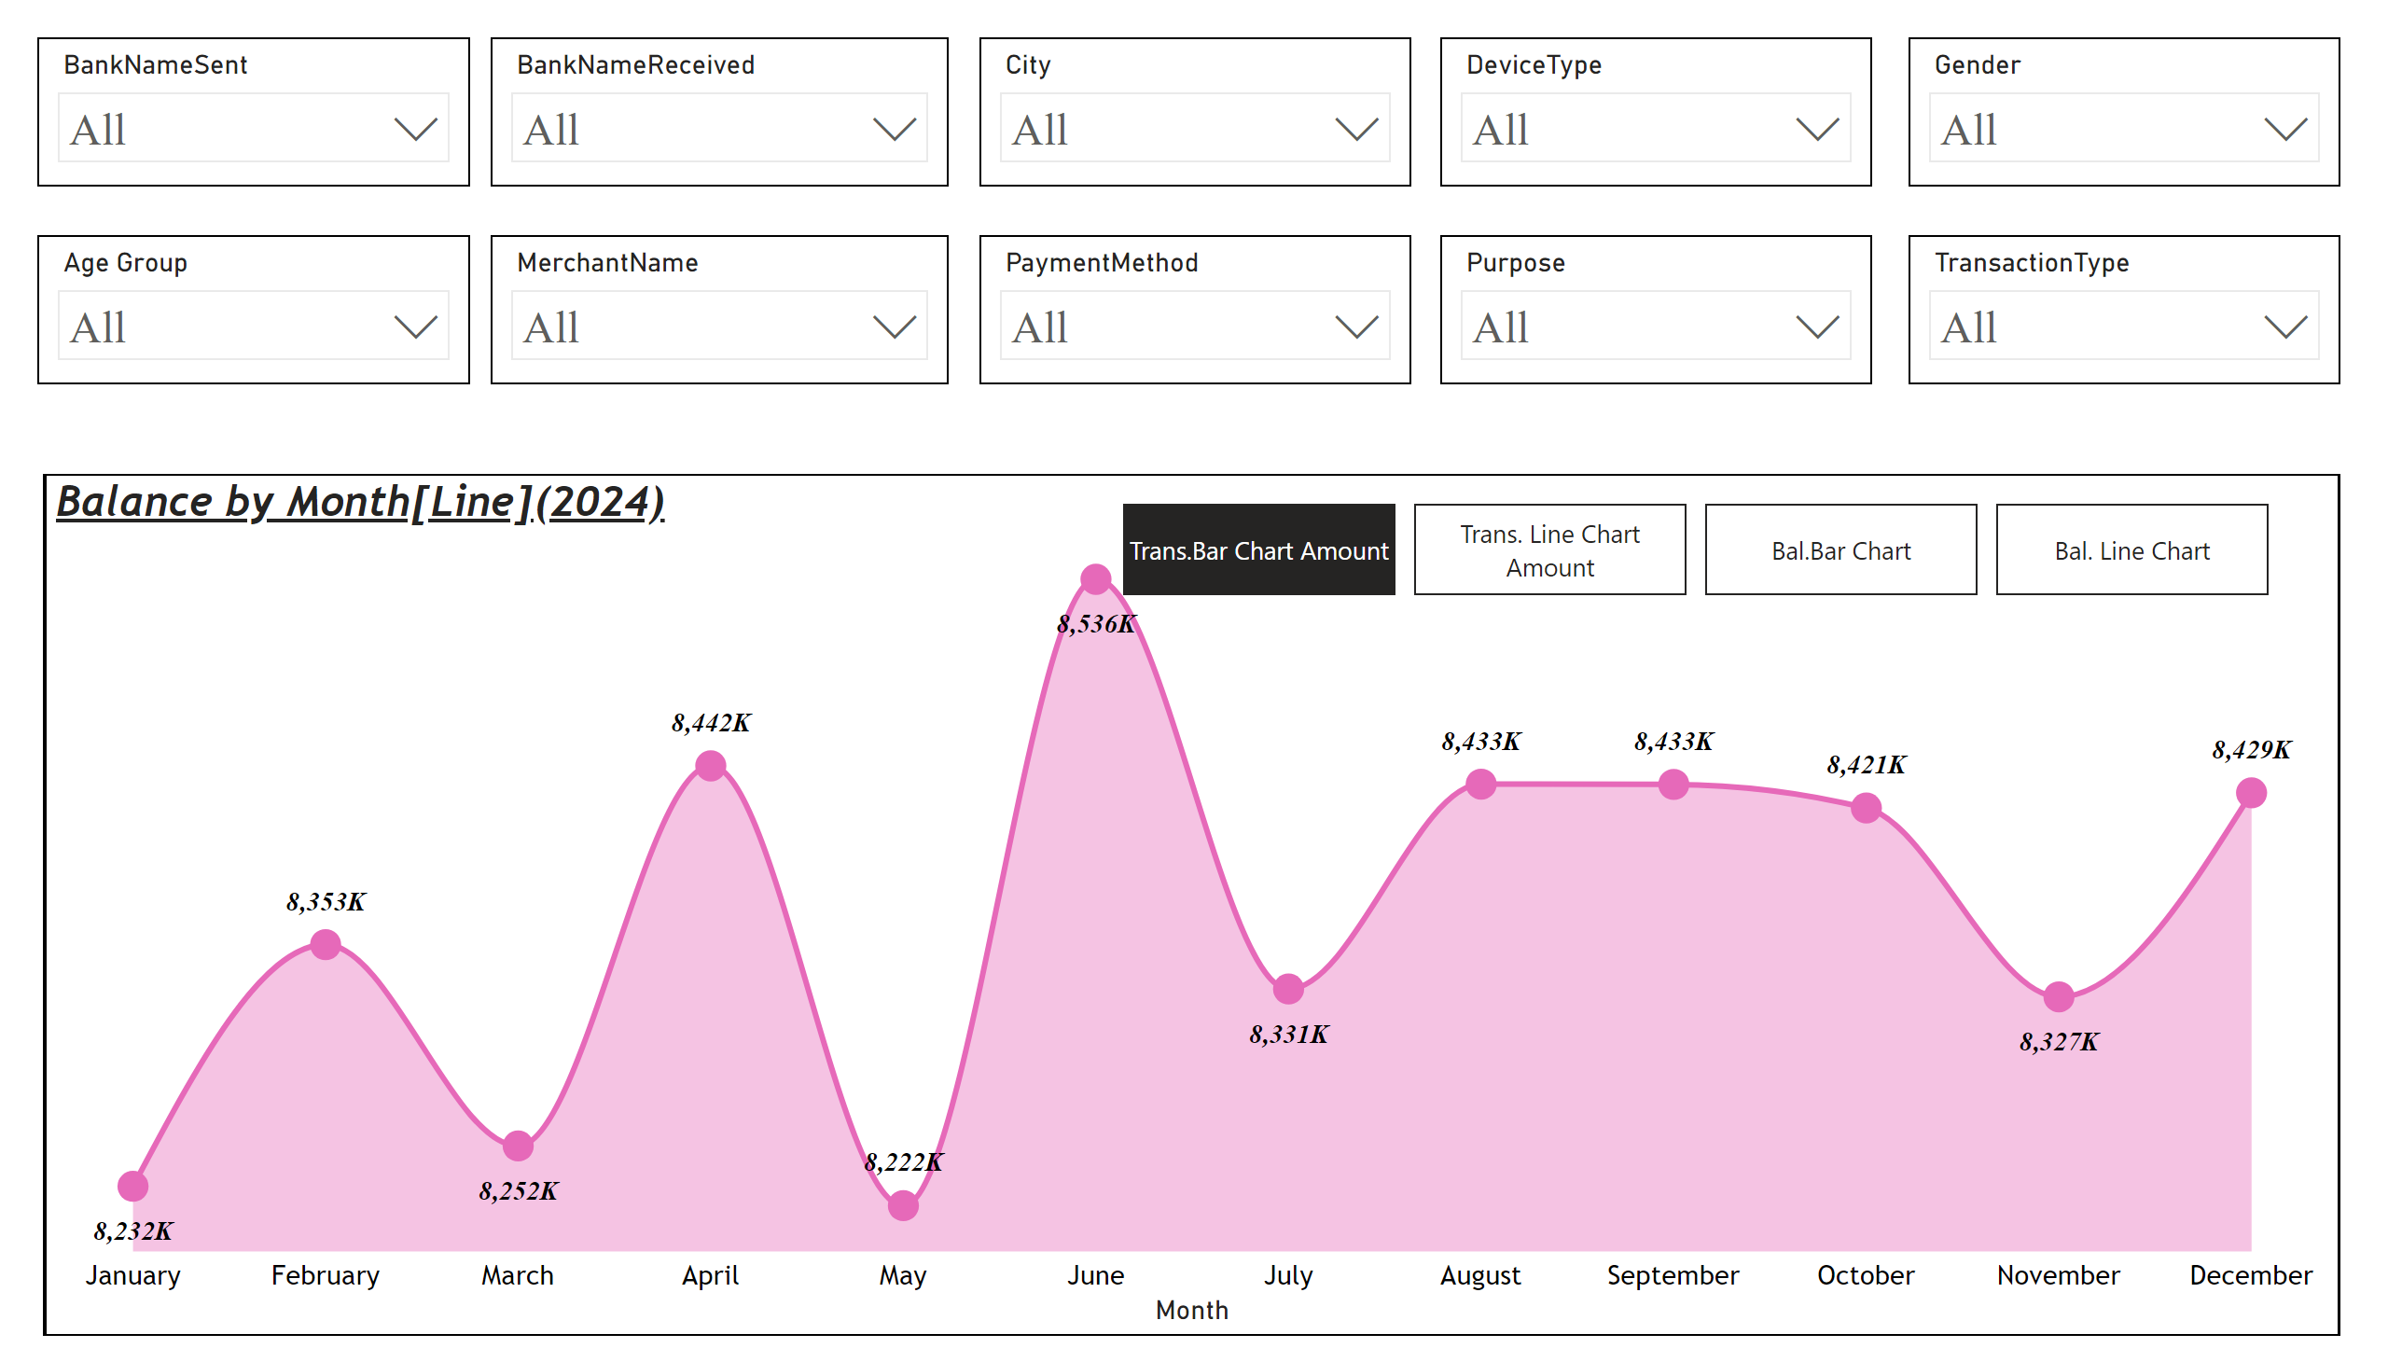
Tran Bar
Notes:
slicer
No alt text provided
slicer
No alt text provided
slicer
No alt text provided
slicer
No alt text provided
slicer
No alt text provided
slicer
No alt text provided
slicer
No alt text provided
slicer
No alt text provided
slicer
No alt text provided
slicer
No alt text provided
lineChart
No alt text provided
Transaction by Month[Column](2024)
No alt text provided
columnChart
No alt text provided
Balance by Month[Line](2024)
No alt text provided
bookmarkNavigator
No alt text provided

Slide 6
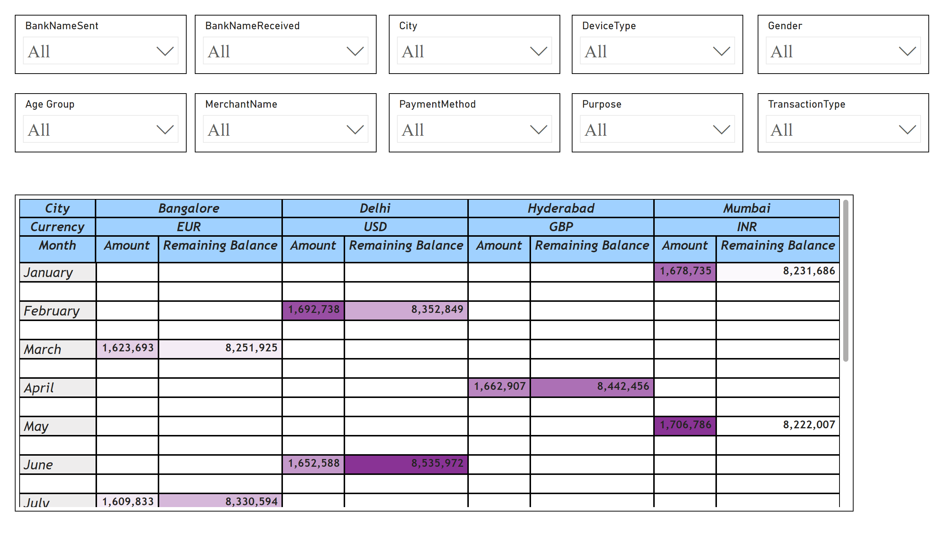
Page 2
Notes:
slicer
No alt text provided
slicer
No alt text provided
slicer
No alt text provided
slicer
No alt text provided
slicer
No alt text provided
slicer
No alt text provided
slicer
No alt text provided
slicer
No alt text provided
slicer
No alt text provided
slicer
No alt text provided
pivotTable
No alt text provided

